Slide 1



Weekly Progress: Chat History and Alternate Suggestions
On Development of an on-Premise AI Product Recommendation Model Using Open-Source LLM
Atique Md Monir Ahammod Bin (248810) 21 May 2025
Department of Artificial Intelligence Convergence

Slide 2

Project Description
Project Title
Development of an on-Premise AI Product Recommendation Model Using Open-Source LLM
Company: Narosu Co. Ltd.
Project Description
The e-commerce market is becoming increasingly competitive, requiring advanced recommendation systems.
Large marketplaces use sophisticated AI models, but independent online store operators lack such solutions.
This project aims to develop an AI-powered product recommendation system tailored for self-managed online stores.
By analyzing customer preferences, the system will suggest products that align with their interests.
Project Objective
Develop an AI-based search and recommendation system that analyzes user input sentences and recommends the TOP 5 most relevant products based on semantic similarity.
Utilize Natural Language Processing (NLP) and vector search technology to provide a highly refined search experience.
Deploy in an on-premise environment to ensure data privacy and full control over the recommendation process.
1

Slide 3

Company Requirements
Selected Model and Vector Store:
Embedding Model: text-embedding-ada-002
Vector DB/Search: Qdrant
LLM Reasoning: Llama 3.1 8B instant
LangChain Framework for LLM
UI Framework: Gradio
API Architecture: Gradio + FastAPI
2

Slide 4

System Configuration (AI Model) Diagram
3

Slide 5
Project Schedule (Gantt Chart)
Phase | 2025
 | March |  |  |  | April |  |  |  | May |  |  |  | June
 | 1 | 2 | 3 | 4 | 1 | 2 | 3 | 4 | 1 | 2 | 3 | 4 | 1 | 2
Project Understanding and Data Collection
Data Analysis and Pre-processing
Model Selection and Training
System (RAG) Development
Chatbot Development
Testing and Deployment
4

Slide 6
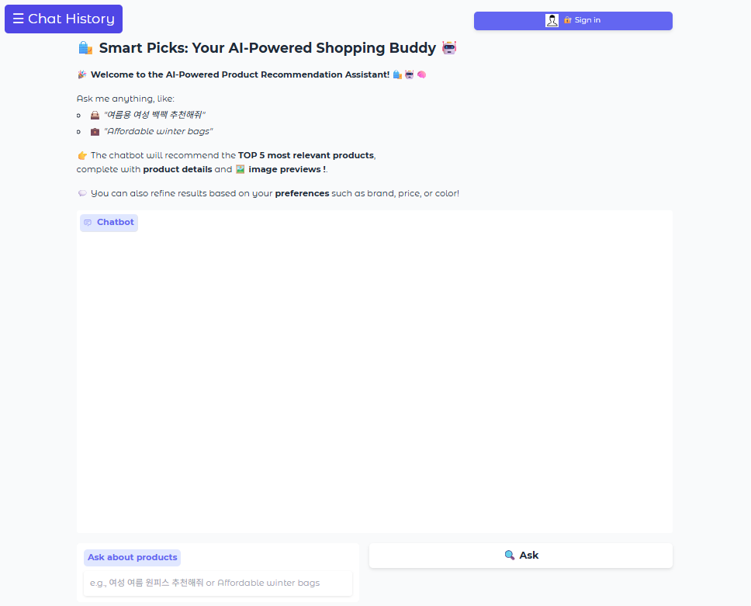
ChatBot UI Update with Chat History and Login/Register
Sign in / Register
Chat History
5

Slide 7
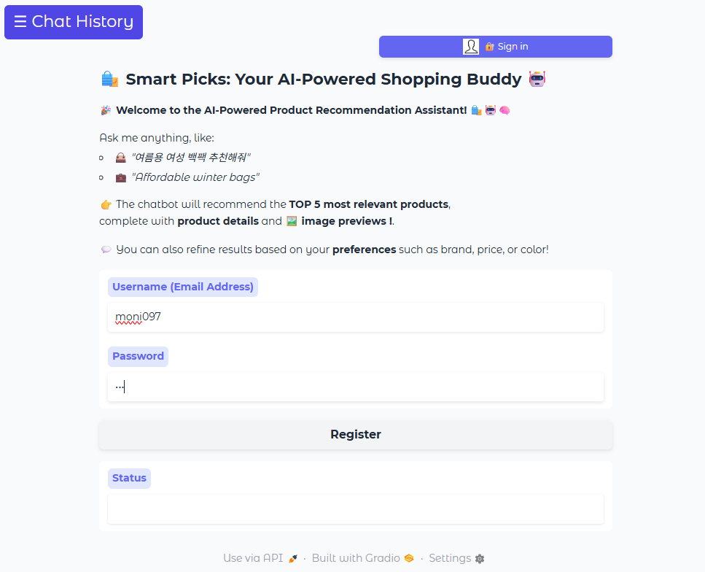
Register for a New User (Cont.)
Register with username and
password
6

Slide 8
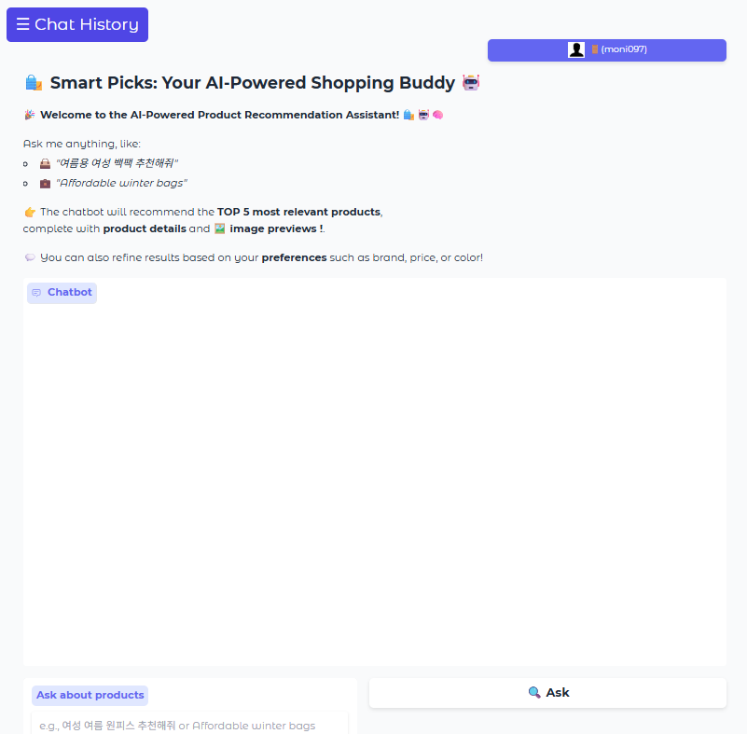
Register for a New User
Logged in for new user: moni097
7

Slide 9
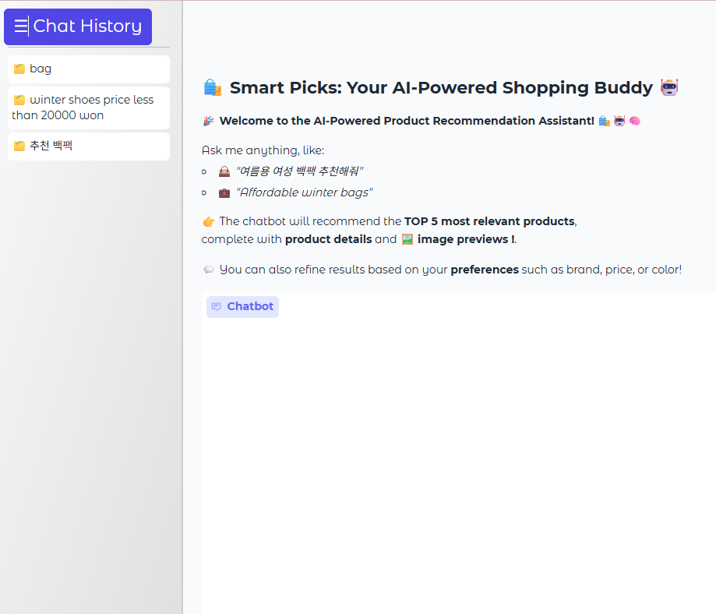
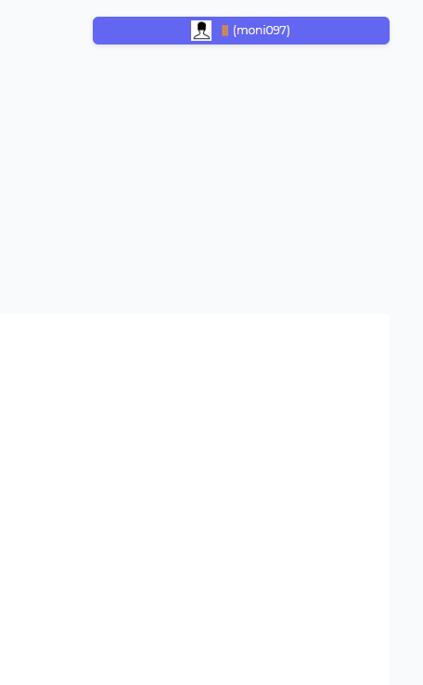
Showing Previous Chat History
Chat history
8

Slide 10
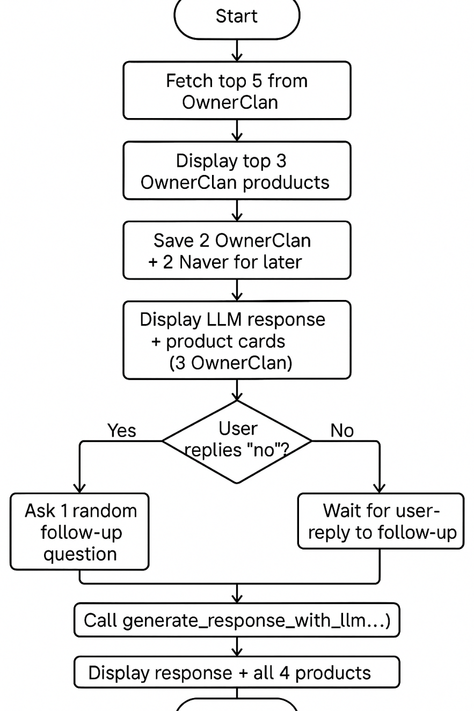
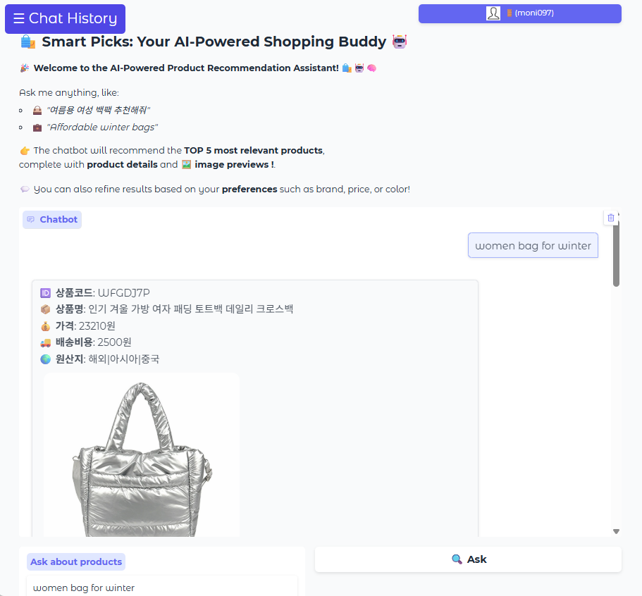
Alternates Suggestions
9

Slide 11
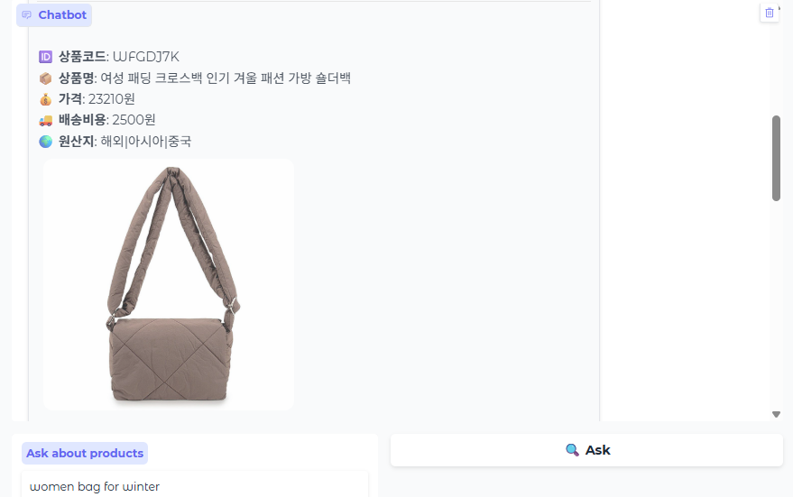
Alternates Suggestions
10

Slide 12
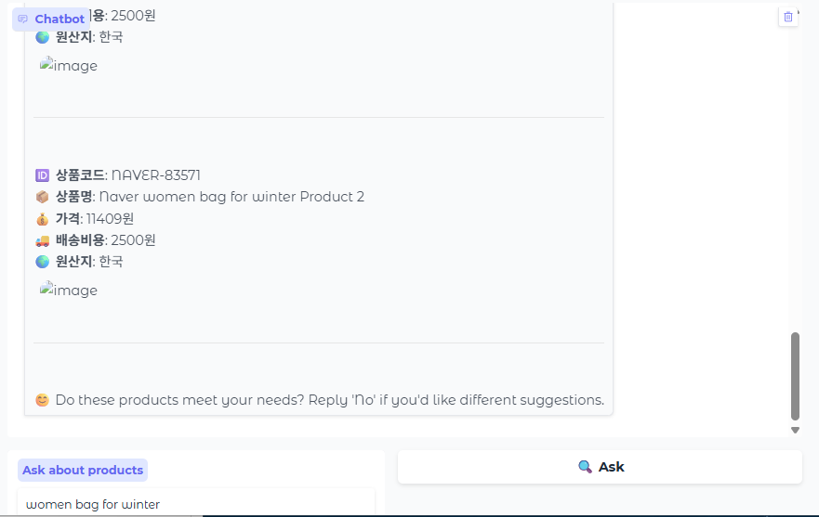
Alternates Suggestions: Meet the Satisfaction?
11

Slide 13
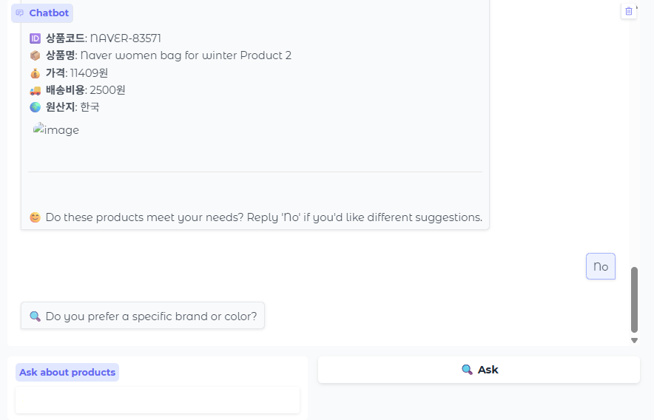
Alternates Suggestions: Random Question for the Alternates
12

Slide 14
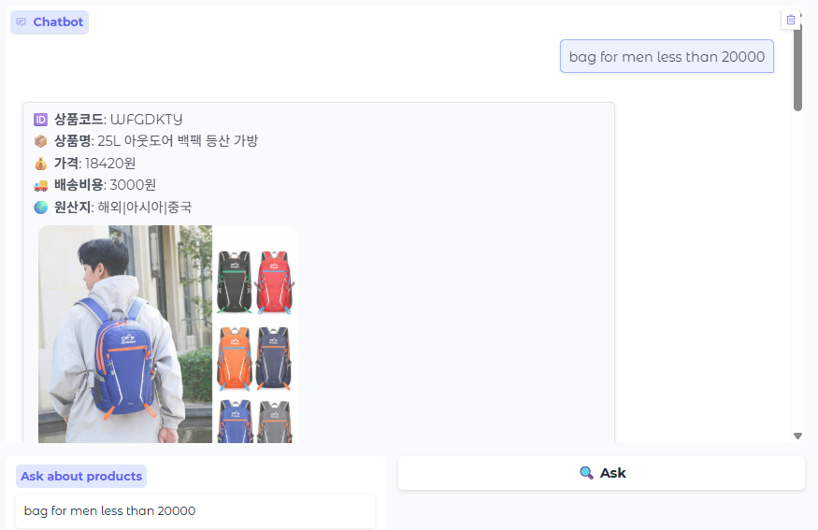
Changed User Query for the Alternates Suggestions
13

Slide 15
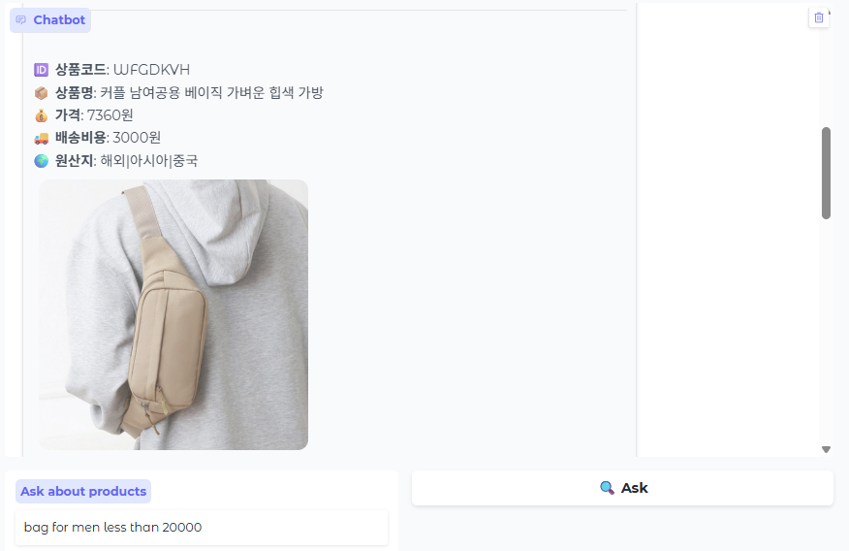
Alternates Suggestions
14

Slide 16
Next Tasks To Do
Next Step
Integrate Naver API call properly for the images also.
15

Slide 17
Thank You for Listening.
16

